Slide 2
Integrity constraints
Integrity constraints are pre-defined set of rules that are applied on the table fields(columns) or relations to ensure that the overall validity, integrity, and consistency of the data present in the database table is maintained.

Slide 3
Integrity constraints
Distributed Database management System(DDBMS) there is a certain set of rules which are used to maintain the quality and consistency of data in the database. Every time there is an insertion, deletion, or updating of data in the database it is the responsibility of these integrity constraints to maintain the integrity of data and thus help to prevent accidental damage to the database.

Slide 4
Purpose of Integrity Constraints
Integrity constraints are an important part of maintaining database correctness. They ensure that the data in the database adheres to a set of rules, which can help prevent errors and inconsistencies.

Slide 5
Types of Integrity Constraints
Domain Constraint
Referential Integrity Constraint
Entity Integrity Constraint
Key Constraint

Slide 6
Domain Constraint
Domain integrity constraint contains a certain set of rules or conditions to restrict the kind of attributes or values a column can hold in the database table. The data type of a domain can be string, integer, character, DateTime, currency, etc.

Slide 7
Entity Integrity Constraint
Entity Integrity Constraint is used to ensure that the primary key cannot be null. A primary key is used to identify individual records in a table and if the primary key has a null value, then we can't identify those records. There can be null values anywhere in the table except the primary key column.

Slide 8
Referential Integrity Constraint
Referential Integrity Constraint ensures that there must always exist a valid relationship between two relational database tables. This valid relationship between the two tables confirms that a foreign key exists in a table. It should always reference a corresponding value or attribute in the other table or be null.

Slide 9
Key Constrains
Keys are the set of entities that are used to identify an entity within its entity set uniquely. There could be multiple keys in a single entity set, but out of these multiple keys, only one key will be the primary key. A primary key can only contain unique and not null values in the relational database table.

Slide 10
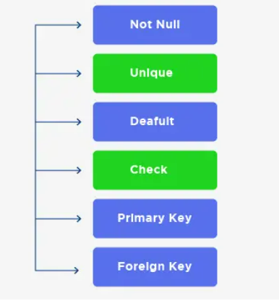
Types of Key Constrains

Slide 11
Importance of Integrity Constraints in ADBMS
Integrity constraints play a crucial role in a ADBMS for ensuring the accuracy, consistency, and reliability of. the data stored in a database
Data Accuracy
Data consistency
Data reliability
Data validation
Data security
Database performance

